Slide 1
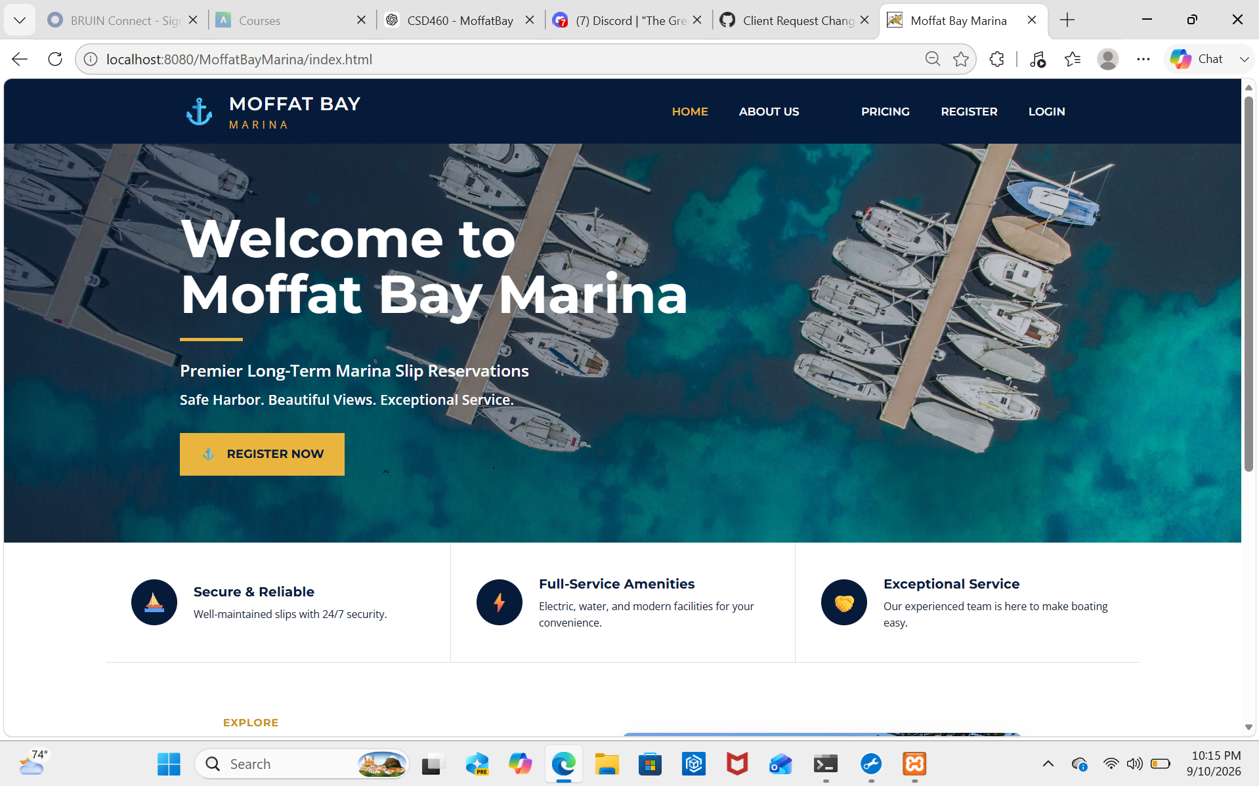
Moffat Bay Marina
Module 10 QA Presentation Draft
Group Green
Jordan Dardar • Aftabur Rahman • Alexander Baldree • Maksvmilian Jankowski
Current landing page prototype
Replace screenshots and test results as Module 9 and deployment are finalized.
Moffat Bay Marina • Group Green • CSD460
Notes:
Hello, my name is Alexander Baldree, and this presentation is about our Moffat Bay Marina project for CSD 460. Our group is Group Green, and the team includes Jordan Dardar, Aftabur Rahman, myself, and Maksvmilian Jankowski.
For this project, we worked together to build and test a marina reservation website. In this presentation, I’m going to go over the main parts of our prototype, how the customer uses the system, some of the testing we completed, and a few things we learned while working through the project.

Slide 2
Team Introduction
Group Green roles and current focus.
Jordan Dardar
Aftabur Rahman
Presentation draft, peer testing support, screenshots, final review
Backend/test support and peer test documentation
Alexander Baldree
Maksvmilian Jankowski
Team coordination and project deployment
Module 9 wait list work, SQL scripts, functional tests
Moffat Bay Marina • Group Green • CSD460
Notes:
For this project, everyone had different responsibilities, but we also helped each other when needed.
Jordan worked on the presentation draft, screenshots, peer testing support, and the final review.
Aftabur helped with backend work, testing, and peer test documentation.
My main responsibilities were team coordination and helping with project deployment. I also helped make sure the different parts of the project worked together as we moved closer to the final version.
Max mainly worked on the Module 9 wait list feature, SQL scripts, and functional testing.
Even though we had different roles, a lot of the work connected together, so communication between the team was important.

Slide 3
Prototype Overview
Customer-facing marina reservation system.
Public visitors can review marina details, contact information, and pricing before signing in.
Customers can register, log in, reserve a marina slip, review reservation details, and look up reservations.
Module 9 expands support for wait list lookup and database-backed availability checks.
The design uses a consistent navy/gold marina theme across pages.
Landing page
Moffat Bay Marina • Group Green • CSD460
Notes:
Our Moffat Bay Marina project is a customer reservation system for a marina.
The public side of the website allows visitors to look through information about the marina, contact information, and pricing before they log in.
Once a customer creates an account and logs in, they can reserve a marina slip, review their reservation information, and look up a reservation later.
For Module 9, we also added more support for the wait list and database-backed availability.
We tried to keep the website consistent across every page by using the same general navy and gold marina design.

Slide 4
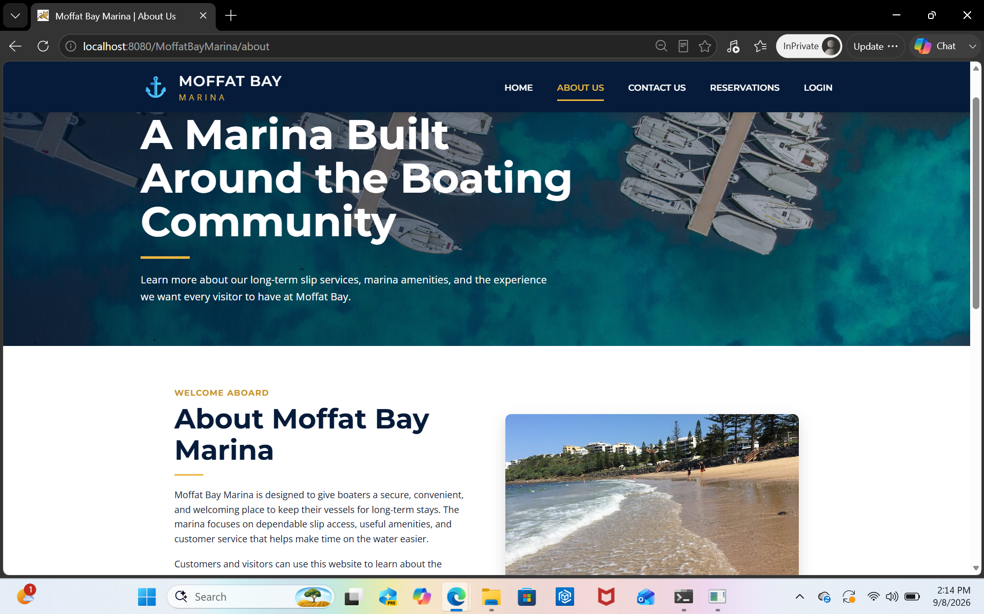
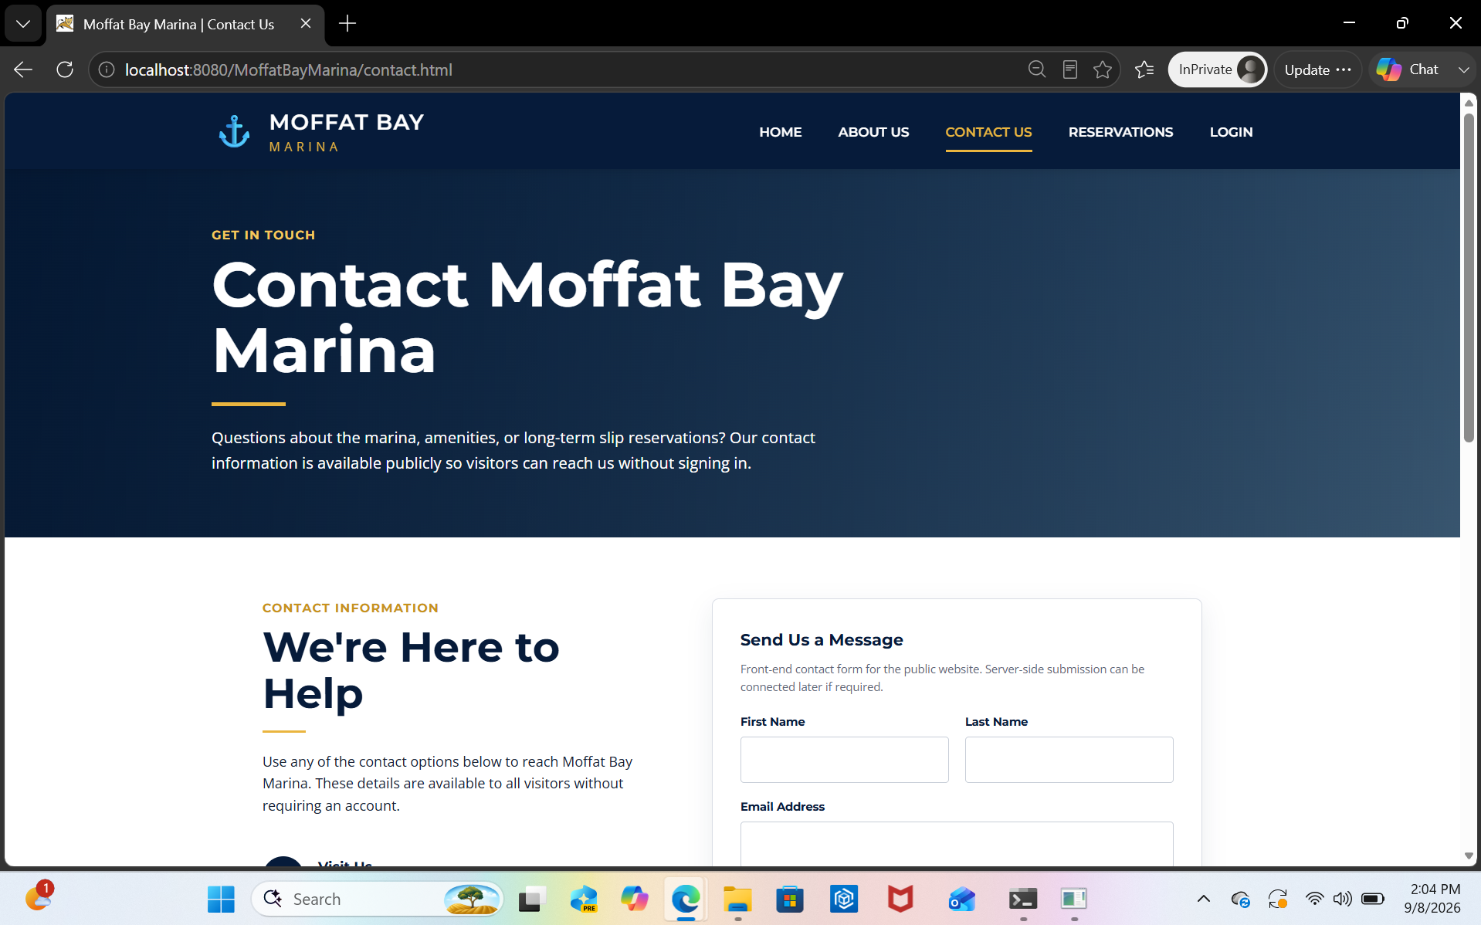
Sample Prototypes: Public Pages
Landing, About Us, and Contact Us pages.
About Us
Contact Us
Public pages are intended to be viewable before login so visitors can understand the marina, contact options, and available services.
Moffat Bay Marina • Group Green • CSD460
Notes:
This slide shows some of the public pages from our website.
These include the landing page, About Us page, and Contact Us information.
The main goal of these pages is to give visitors useful information before they have to log in or create an account.
The landing page gives the user a starting point for the website. The About Us section gives more information about the marina, and the contact information gives customers a way to reach out if they need help or have questions.
Making these pages public helps the customer understand the marina and the services that are available before they move into the account or reservation process.

Slide 5
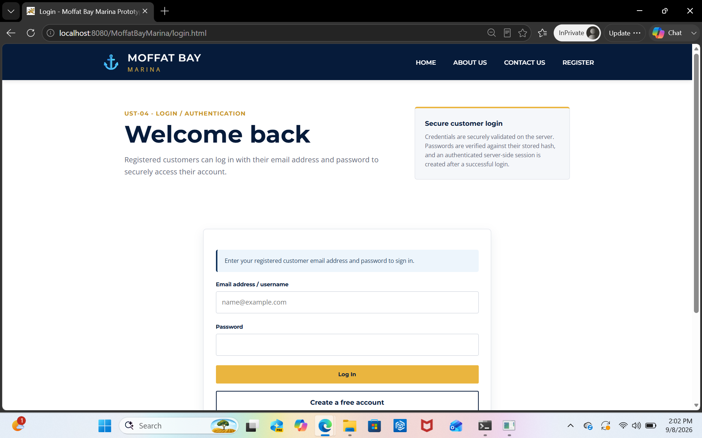
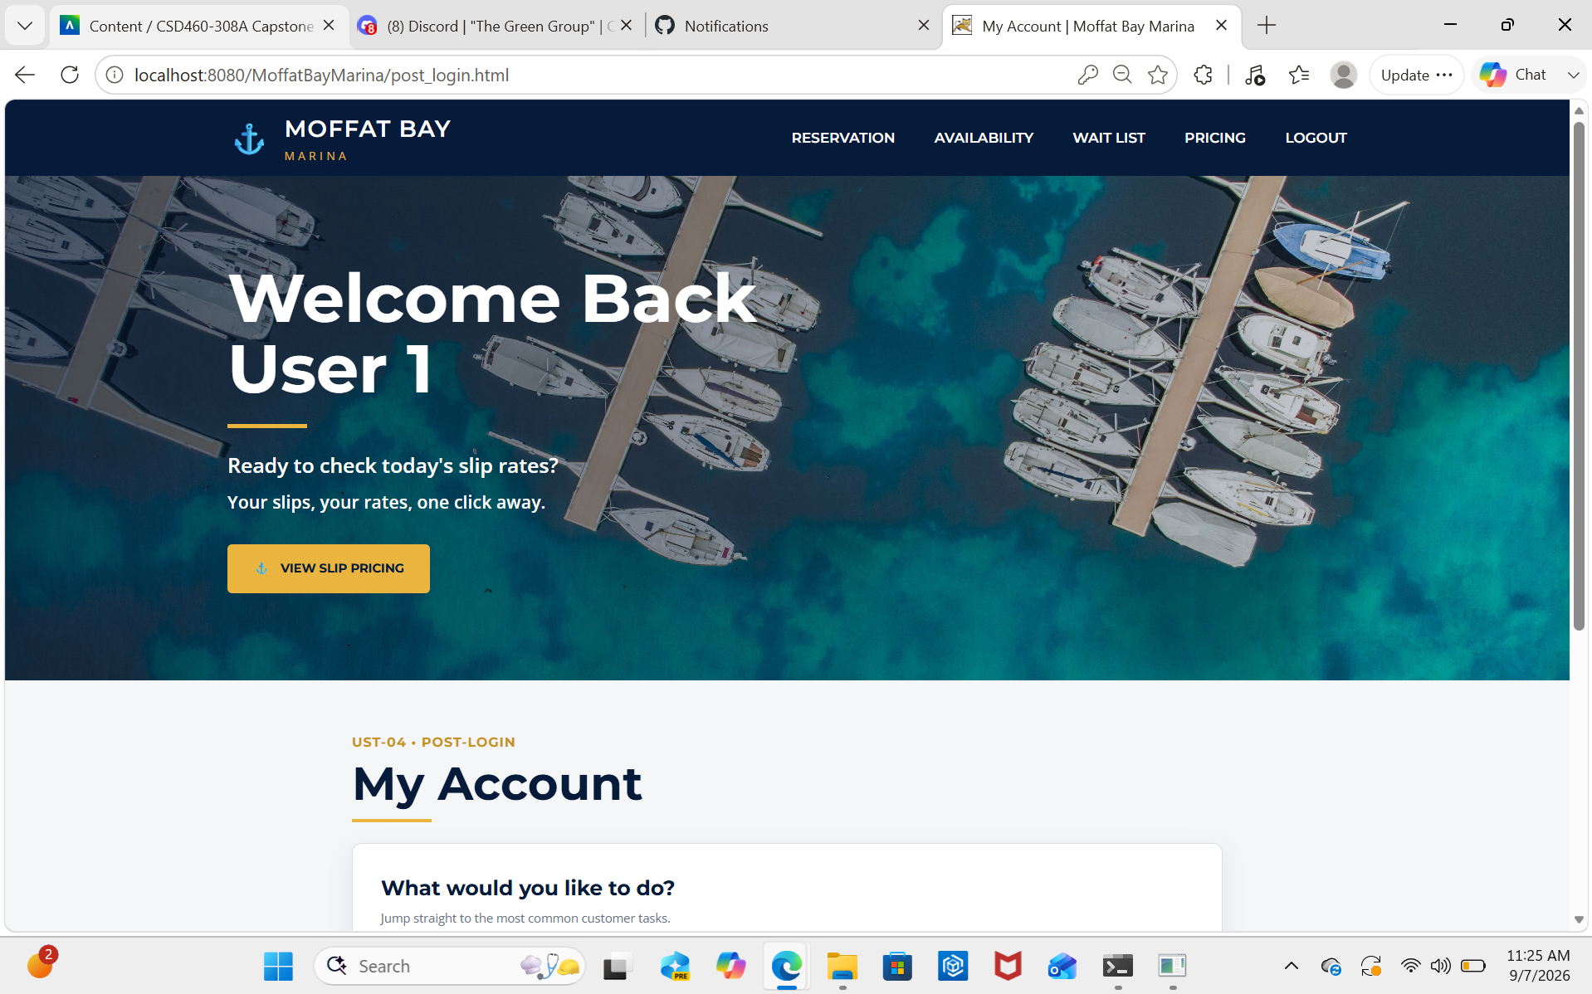
Sample Prototypes: Customer Account Flow
Login and authenticated account dashboard.
Login page
Post-login account view
Credentials are validated before opening authenticated features.
Authenticated customers can reach pricing, reservation, and wait list workflows.
Registration and login should be included in the final screen-capture walkthrough.
Moffat Bay Marina • Group Green • CSD460
Notes:
This slide shows the customer account side of the website.
The customer can either register for an account or log in with an existing account.
Before they can access the private parts of the website, their login information has to be checked and validated.
After they are logged in, they can access features such as pricing, reservations, account information, and the wait list process.
One thing we wanted to make sure of was that the customer could move from the public pages into the logged-in part of the site without the process becoming confusing.
Registration and login are also important parts of the final walkthrough because they show how the customer gets access to the main features of the site.

Slide 6
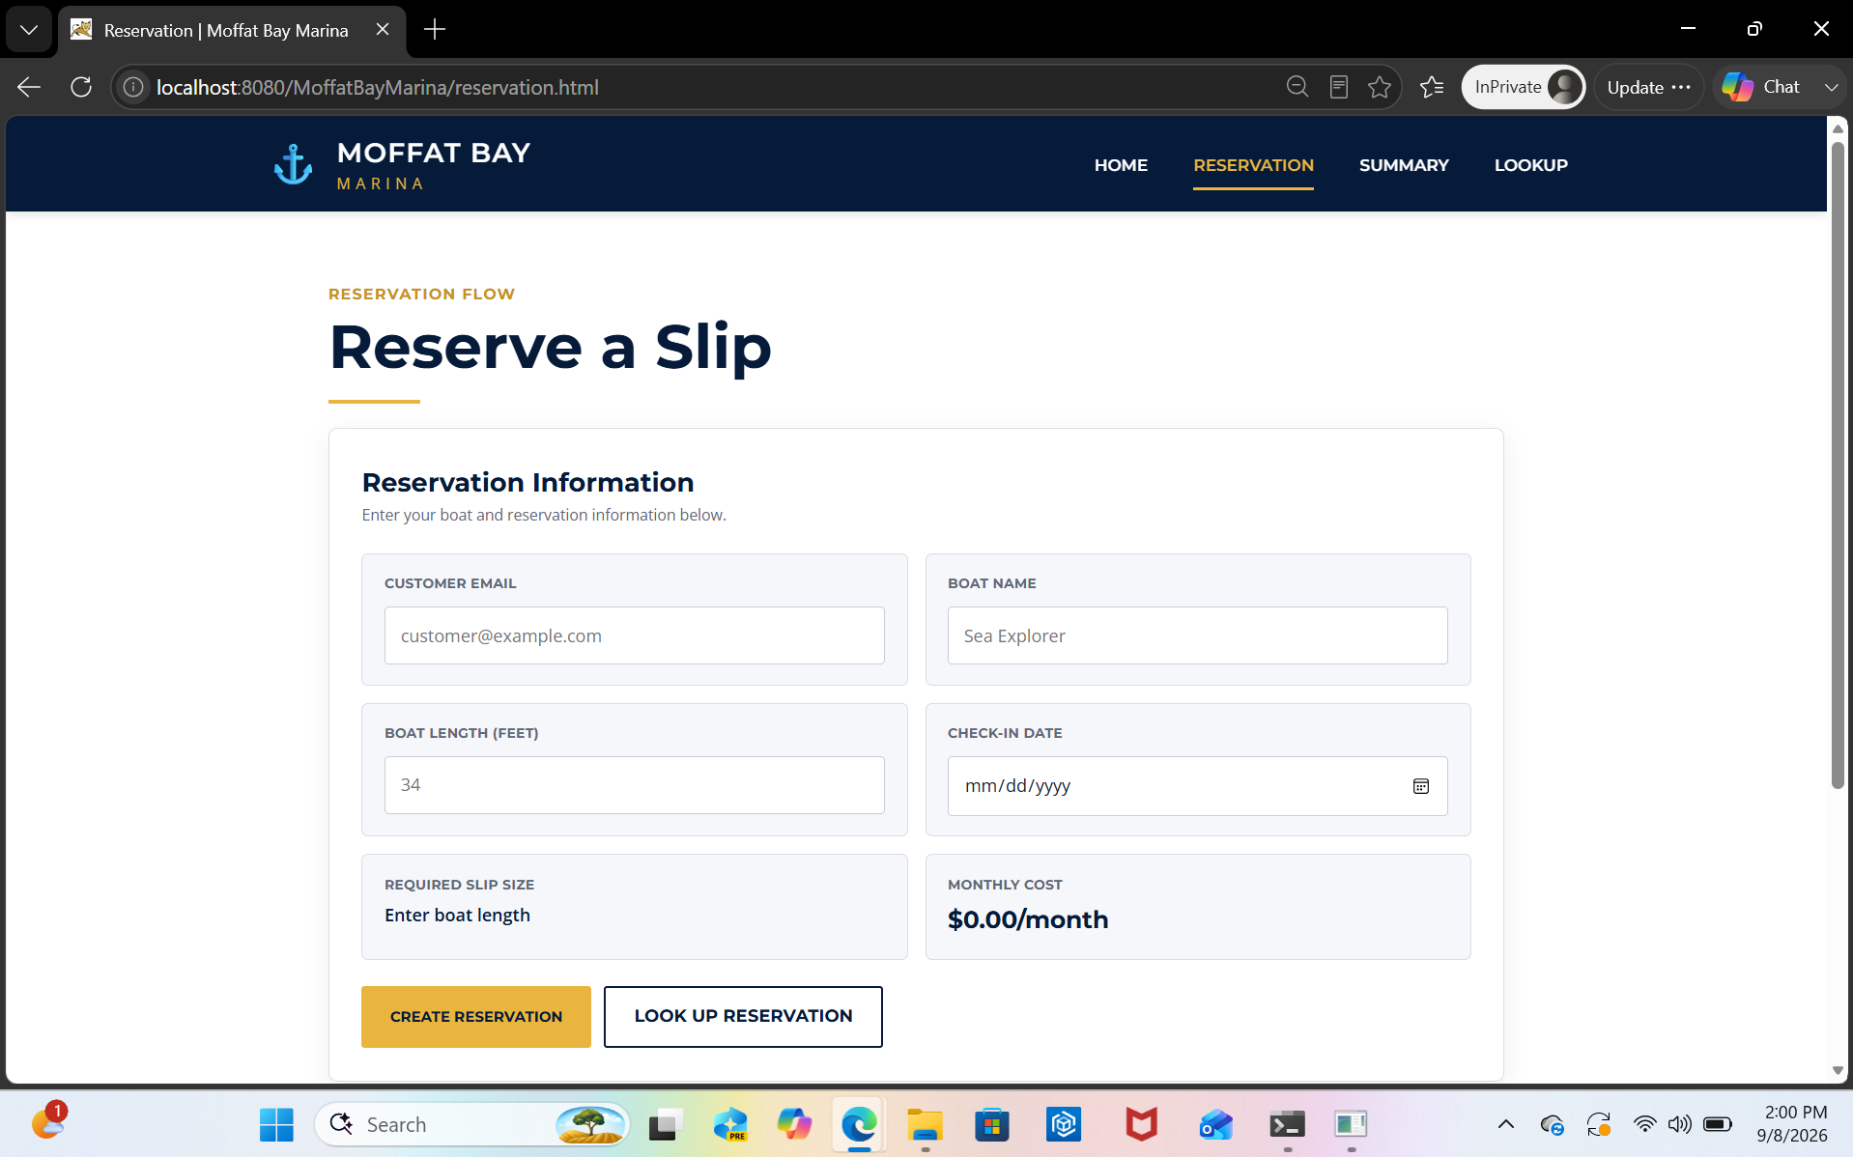
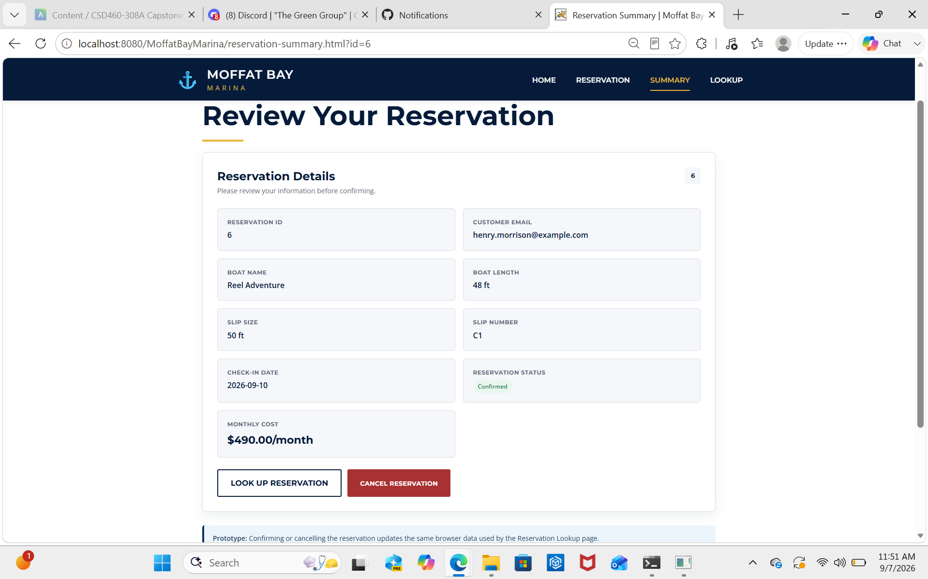
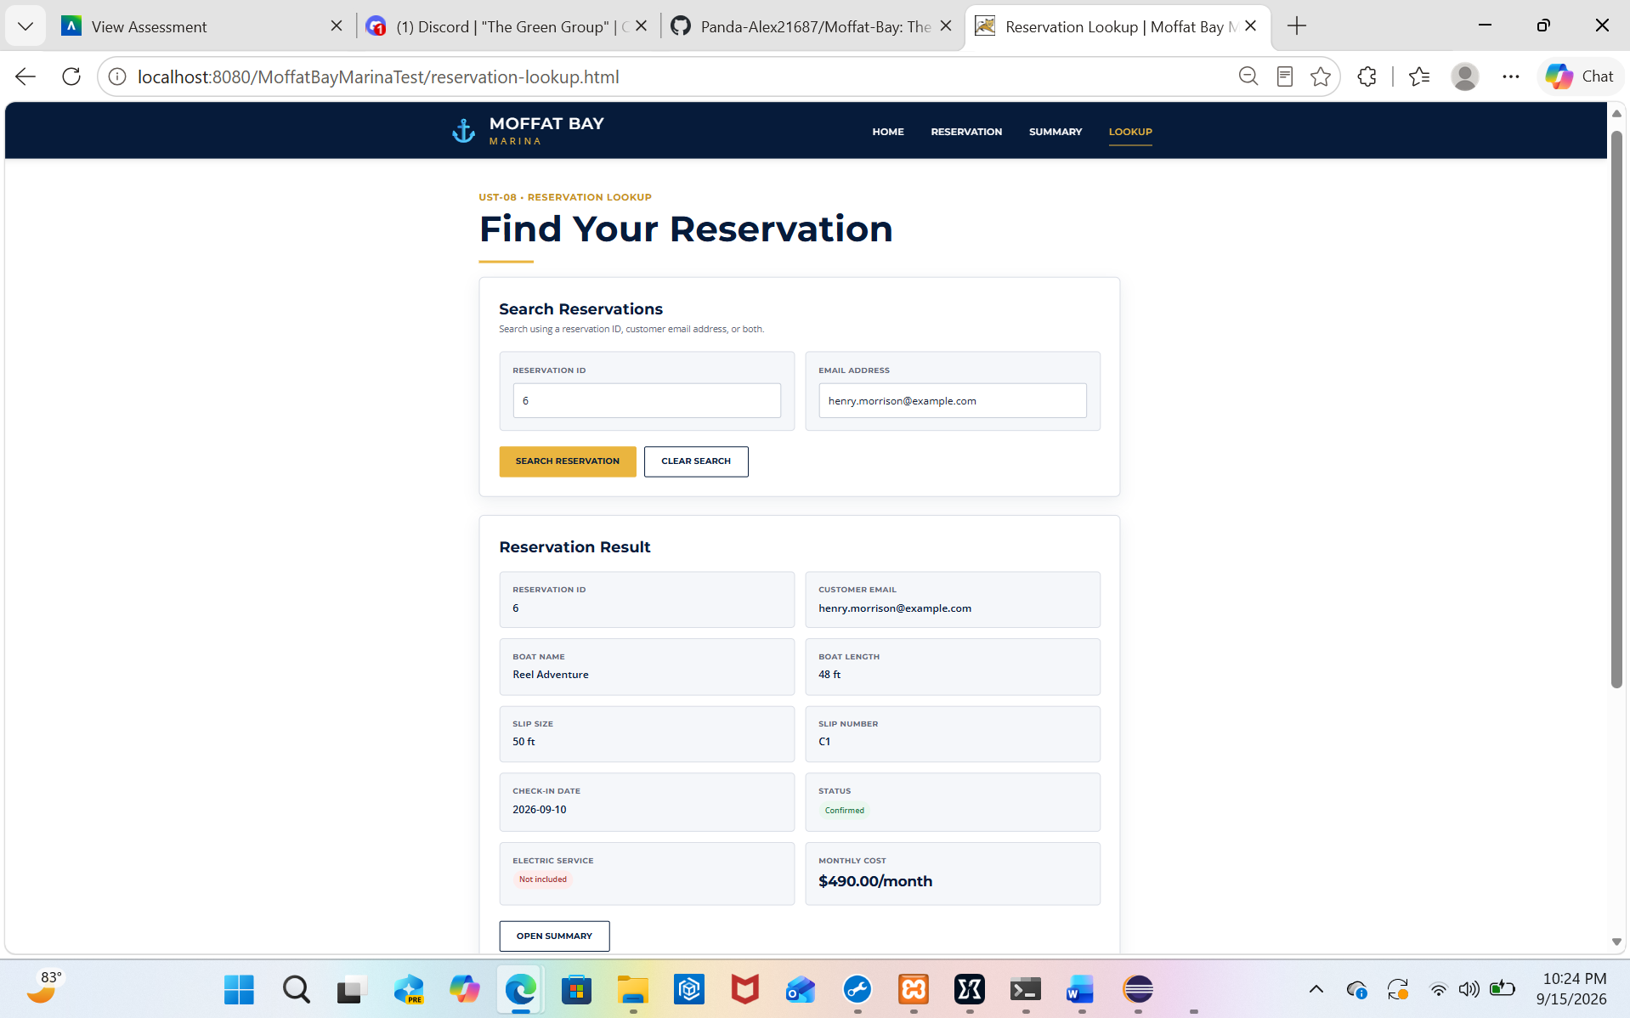
Sample Prototypes: Reservation Flow
Slip reservation, summary, and reservation lookup pages.
Slip reservation
Reservation summary
Reservation lookup
The flow supports entering boat/reservation information, reviewing reservation details, and retrieving the reservation later by ID and email.
Moffat Bay Marina • Group Green • CSD460
Notes:
This slide shows the main reservation process.
The customer starts by entering information about their boat and the reservation they are trying to make.
After the reservation is created, the reservation summary gives them a chance to review the information that was entered.
We also created a reservation lookup feature so the customer can come back later and find their reservation using information such as the reservation ID and email address.
This process is important because the customer should be able to make a reservation, review it, and then come back later without having to start everything over again.

Slide 7
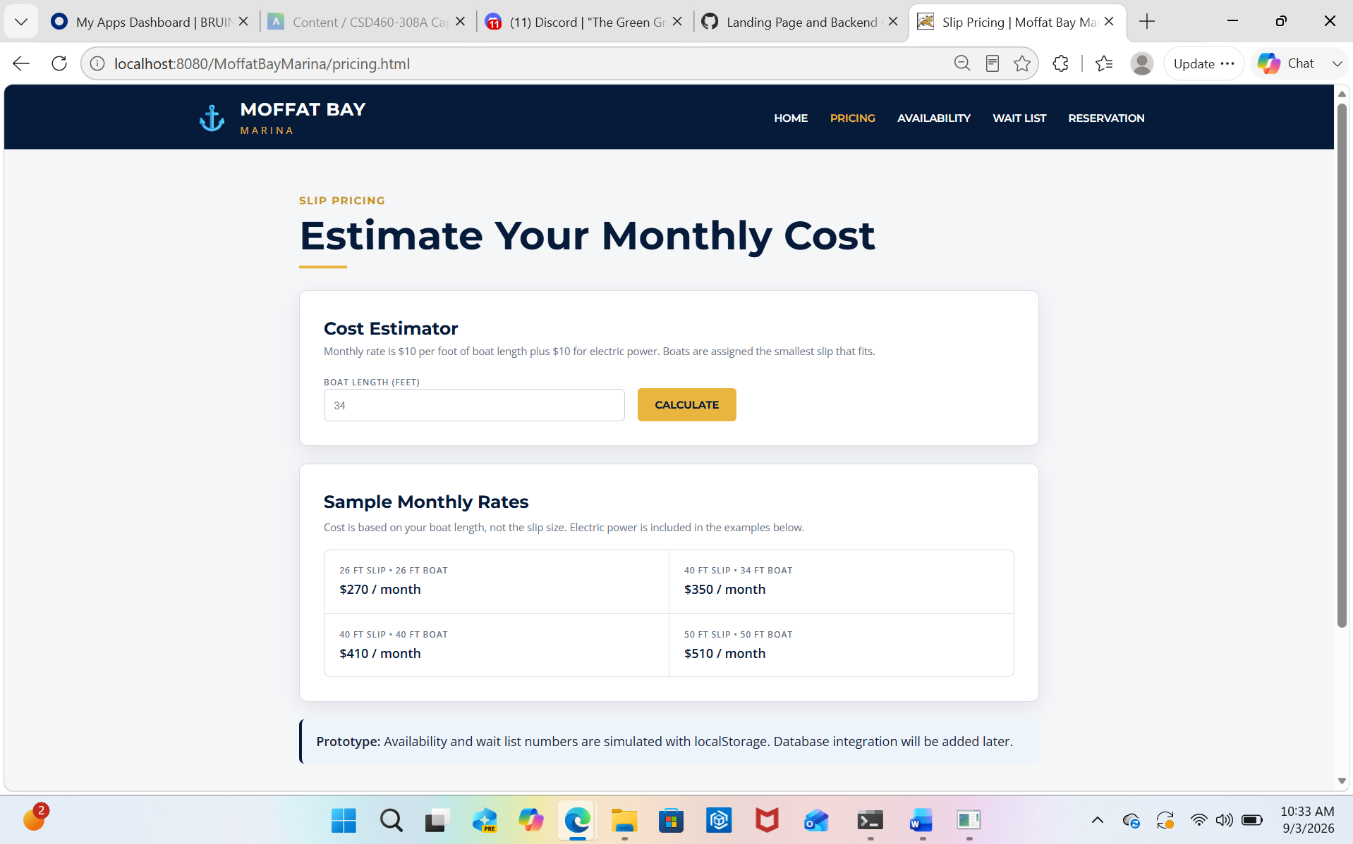
Module 9 Focus: Wait List Lookup
Waiting on final test screenshots and SQL results from the Module 9 owner.
Module 9 assignment: Wait List Lookup page and backend code.
Functional tests should verify database-backed availability and wait list counts.
Max is preparing SQL scripts for the peer reviewer.
Final deck update: add screenshots from the completed wait list tests once the team posts them.
Pricing / availability-related prototype
Do not lock this slide until electric opt-in and departure date updates are finished.
Moffat Bay Marina • Group Green • CSD460
Notes:
Module 9 focused on the wait list lookup feature.
The purpose of this feature is to work with the database and check whether a certain type of marina slip is available.
If the slip is not available, the system can also use the wait list information to show how many customers are already waiting.
Testing this feature is important because the information being shown to the customer needs to match the information stored in the database.
At the time this presentation draft was made, some of the final screenshots and SQL test results were still being completed.
There were also updates involving the electric option and departure date that still needed to be finished before this section was completely locked in.

Slide 8
ERD and Database Scope
Editable placeholder until the final ERD is posted.
Core customer data: account identity, login credentials, and contact information.
Reservation data: reservation ID, customer, boat name, length, check-in date, slip size/number, status, and monthly cost.
Slip capacity data: slip type, size, availability, and wait list counts.
Module 9 changes still needed: electric opt-in and departure date.
ERD PLACEHOLDER
Replace this box with the final ERD screenshot once Max/Alex finish the electric opt-in and departure date updates.
Tables likely represented:
customers • reservations • slips • slip_types • waitlist_entries • contact_messages
Moffat Bay Marina • Group Green • CSD460
Notes:
This slide gives an overview of the database behind the project.
The database stores the information needed for the website to work correctly.
For customer accounts, this includes login information and contact details.
For reservations, the database can store information such as the reservation ID, customer, boat name, boat length, check-in date, slip information, reservation status, and monthly cost.
It also stores information about the available slips, including the slip type, size, availability, and wait list counts.
Some of the tables connected to the project include customers, reservations, slips, slip types, wait list entries, and contact messages.
One thing we learned during development was that changes to the database also have to match the Java code. If one side changes and the other does not, it can create problems in the application.

Slide 9
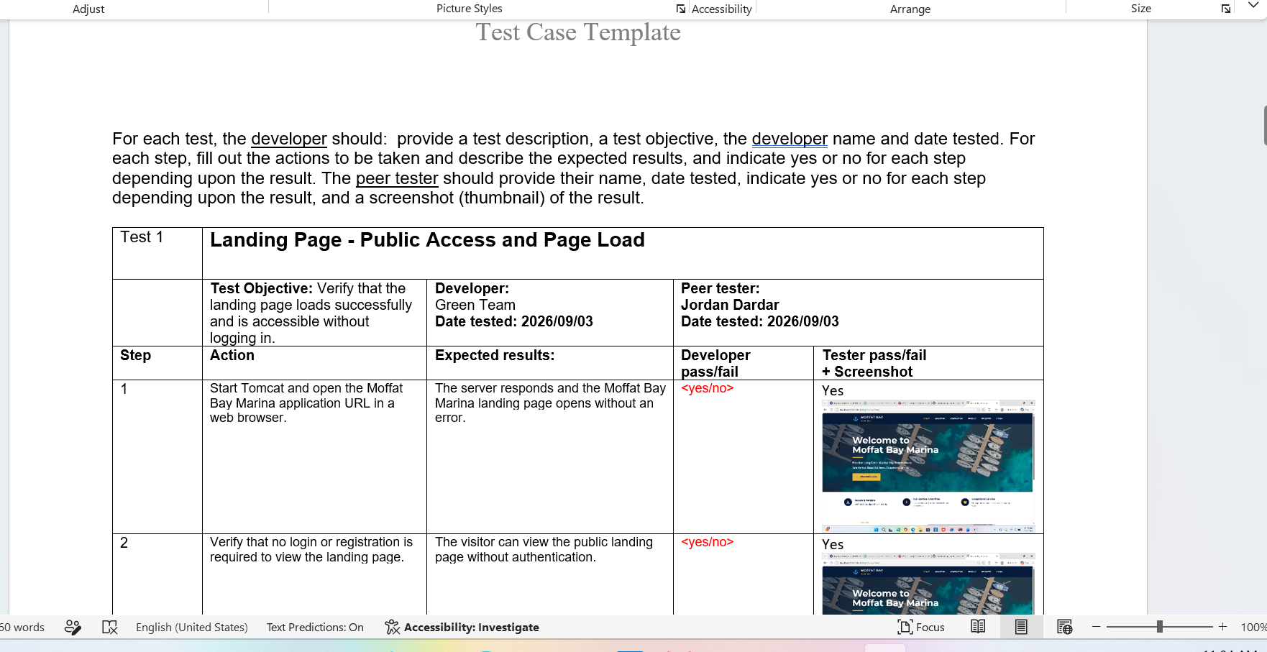
Tests Created and Results
Use the final team results before submission.
Test
Purpose
Result
Landing page load
Public landing page opens without login.
PASS
About/Contact access
Public information and contact form are reachable.
PASS
Login / account access
Customer can access authenticated flow.
PASS / verify live
Slip reservation flow
Reservation form, cost, and summary details are shown.
PASS
Reservation lookup
Valid/invalid lookup behavior and data display.
PASS
Wait list lookup
Availability and wait list count SQL results.
PENDING Module 9
REMINDER: replace any pending result with the exact Module 9 test result after peer review is complete.
Test plan format used for peer evidence
Moffat Bay Marina • Group Green • CSD460
Notes:
Testing was a big part of making sure the website worked correctly.
We tested the landing page to make sure it could be opened without requiring a login.
We also tested the About and Contact information to make sure those public areas were available.
The login and account access were tested to make sure customers could get into the authenticated part of the website.
We also tested the slip reservation flow, reservation summary information, and reservation lookup.
For the wait list feature, the final database and SQL results were still connected to the Module 9 testing in this version of the presentation.
We also tried to keep our testing documentation consistent by including the developer, tester, dates, pass or fail results, screenshots, and comments.
This made it easier for us to see what was working and what still needed to be corrected.

Slide 10
Lessons Learned
Team takeaways from building and testing the prototype.
Keep database scripts and Java code synchronized so new columns match the running application.
Use the test plan template consistently: developer/tester names, dates, pass/fail, screenshots, and comments.
Coordinate earlier in Discord and tag the group when a meeting or test pass is starting.
Keep presentation assets editable and simple so the whole team can revise them quickly.
Deployment should be tested before final recording so the screen capture shows the live site smoothly.
Moffat Bay Marina • Group Green • CSD460
Notes:
There were several things I learned while working on this project with the team.
One of the biggest things was how important it is to keep the database and the Java code updated together.
If someone changes something in the database but the code is still expecting the older version, it can cause errors pretty quickly.
Another thing we learned was that using the same test plan format makes it easier for everyone to understand the results.
Communication was also important. When the team communicated earlier about meetings, testing, or changes, it helped keep everyone working with the same information.
We also learned that keeping our project files and presentation easy to edit made it easier for multiple people to update them.
Deployment was another important part because we needed to make sure the live website worked before recording the final walkthrough.

Slide 11
Screen Capture Plan
Voice-over walkthrough order for the live-site recording.
1. Landing Page: introduce the marina and public navigation.
2. About Us: explain marina purpose and public information.
3. Contact Us: show contact options/form.
4. User Registration: create or review account setup.
5. Login: sign in as a customer.
6. Slip Reservation: enter boat/reservation information.
7. Reservation Summary: review reservation details.
8. Look Up Reservation: retrieve a reservation by ID/email.
9. Wait List Lookup: show availability/wait list result once Module 9 is finalized.
Example page for screen capture flow
Moffat Bay Marina • Group Green • CSD460
Notes:
For our final screen capture, we planned to show the website in the same general order that a customer would use it.
We would start on the landing page and show the main navigation and information about Moffat Bay Marina.
From there, we would go to the About Us section and show the public information and contact options.
Next, we would go through the registration process and then log into a customer account.
After logging in, we would show the slip reservation process and enter the required boat and reservation information.
Then we would review the reservation summary and show how the reservation can be found again using the lookup feature.
The last part would be the wait list lookup, where we would show the availability and wait list information after the Module 9 work was finalized.
Any Questions?

